Slide 1

How has the sale of Single Use Plastic Bags changed over time in England since the introduction of the mandatory surcharge by the Government?
Presented by Asha Makwana
Notes:
1. Today I’m going to be talking about Plastic
In particular Single Use Plastic Bags
I’m going to be exploring if a government policy that was introduced to tackle this problem has actually worked

Slide 2
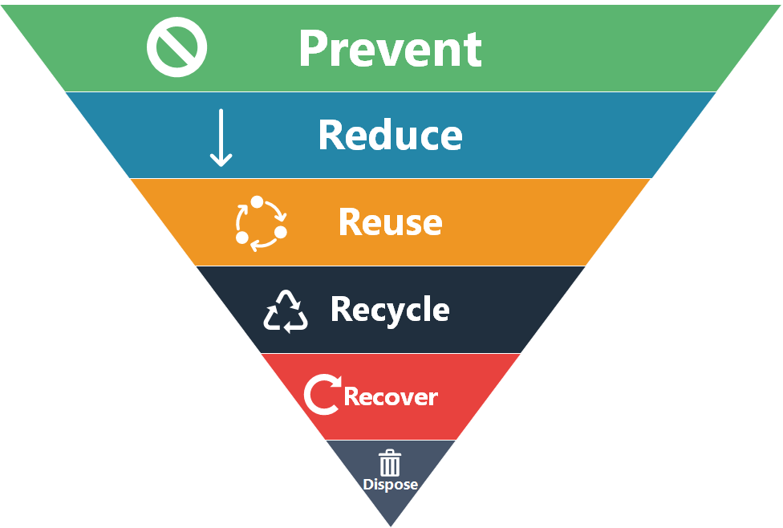
THE WASTE PROBLEM
THE WASTE HIERARCHY PYRAMID
Using less material in design & manufacture
Keeping products for longer and avoiding disposable or single-use goods
Using durable glasses, mugs, cups, plates and cutlery instead of disposable alternatives
Turning waste into a new substance/ product
Recovering energy that is fed into energy grid
WHEN EVERYTHING ELSE FAILS -> LANDFILL
Sources:
https://axil-is.com/waste-management-hierarchy/
https://assets.publishing.service.gov.uk/government/uploads/system/uploads/attachment_data/file/69403/pb13530-waste-hierarchy-guidance.pdf
Notes:
2. Lets talk about waste, we are all guilty of producing waste
This is the waste hierarchy pyramid
As you can see there's plenty of things we can do to Prevent, Reduce, Reuse, Recycle and Recover waste before it ends up in the landfill

Slide 3
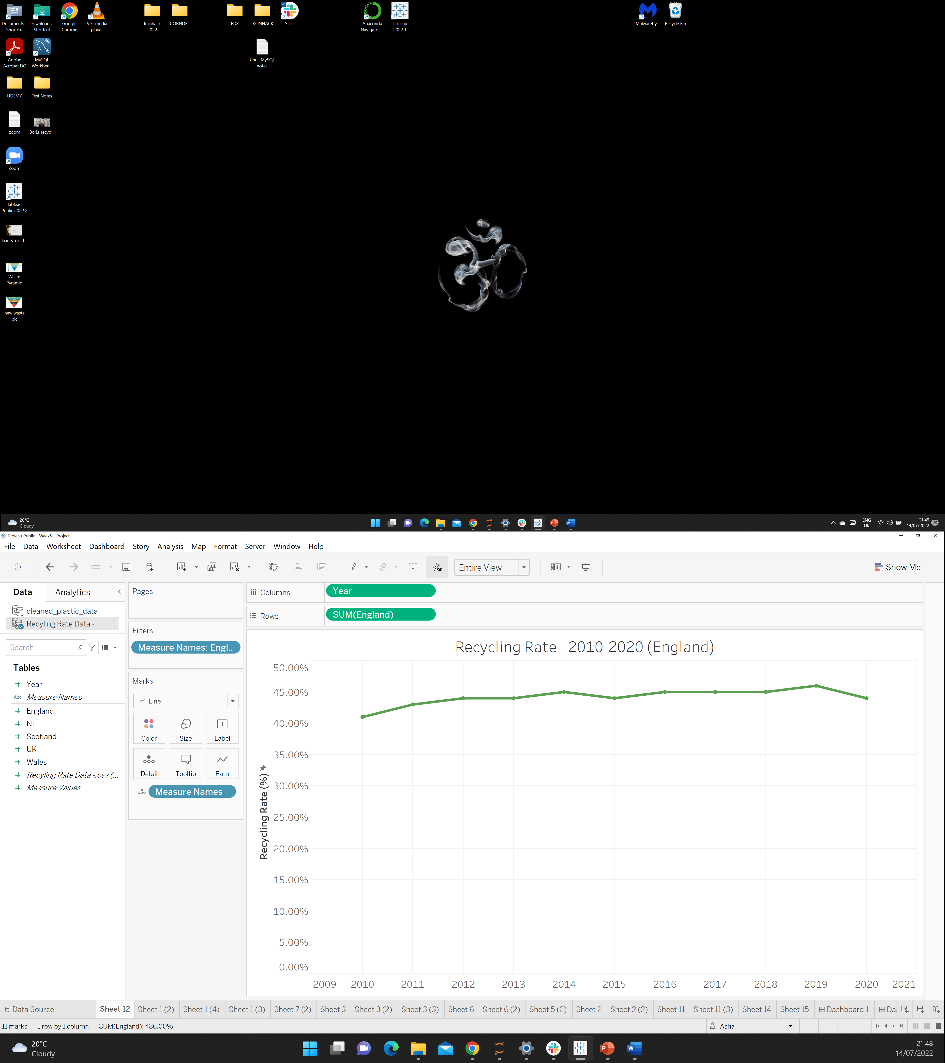
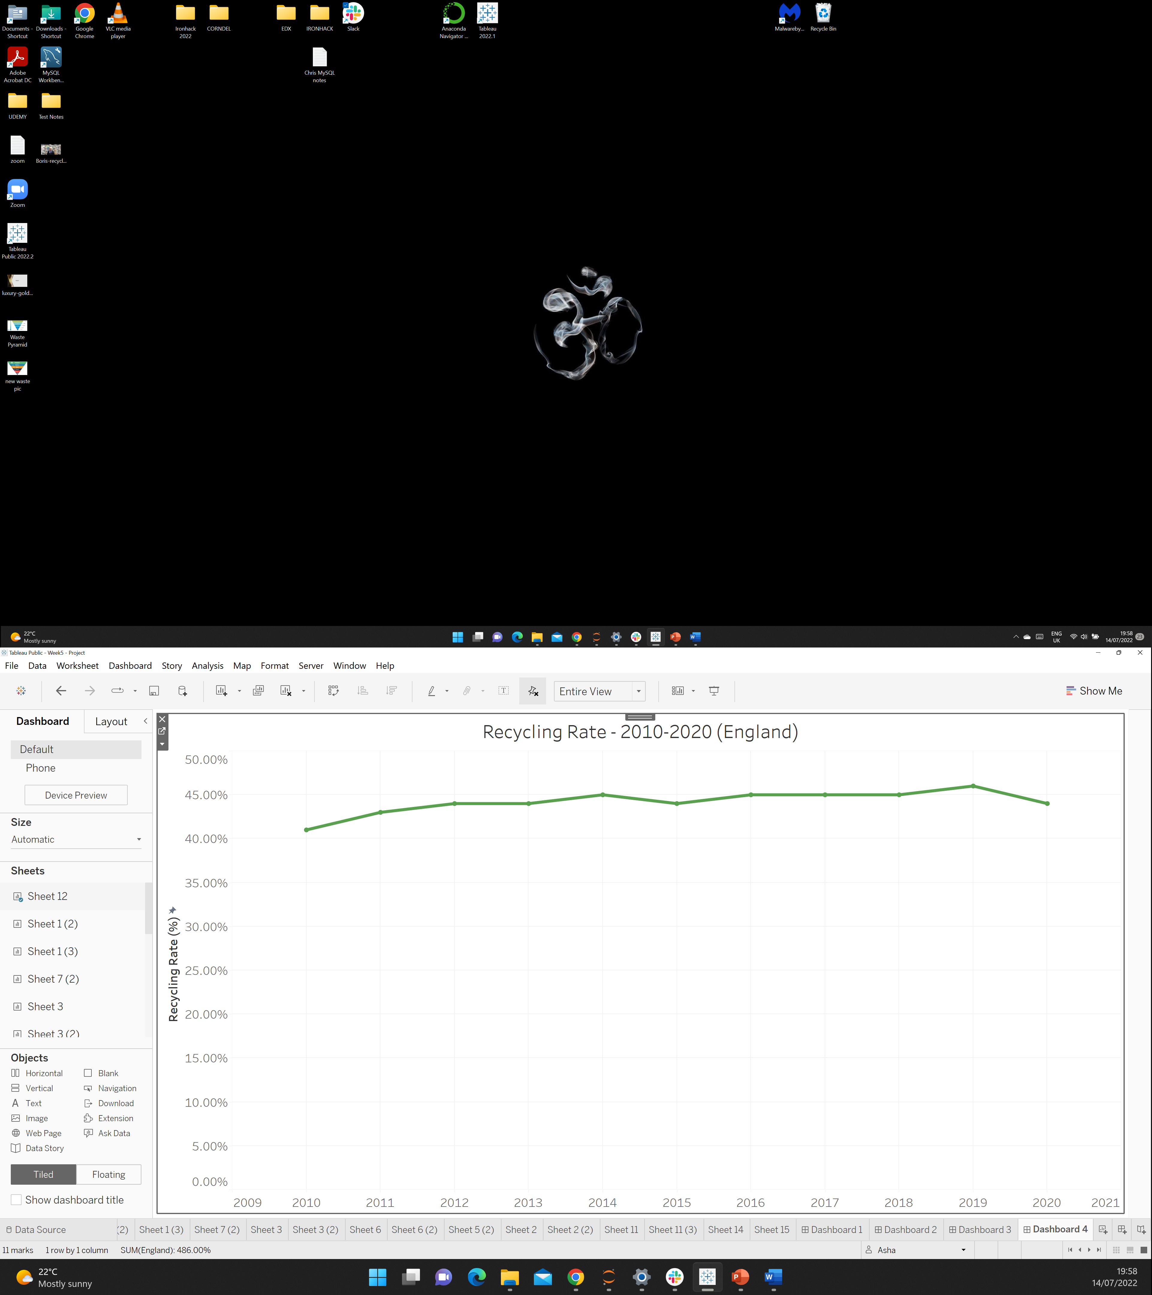
RECYCLING – Are we doing enough?
The Recycling rate has remained between 41% - 44%
Increasing population
Lack of collection and segregation
Recycling is the 4th Step in the Waste Hierarchy
Notes:
3. If we look at all the waste that we produce in England, we can see the recycling rate has remained pretty constant.
This is a problem because we have an increasing population which produces more waste
Recycling is the 4th step in the waste hierarchy pyramid, so its quite low down. And next step recovery actually uses chemical processes and is very expensive

Slide 4
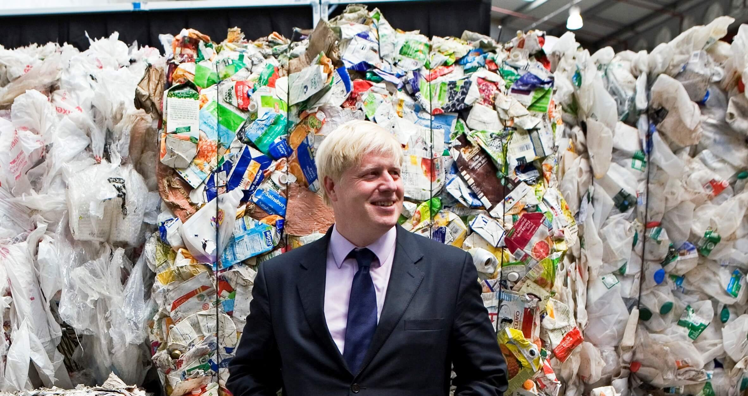
RECYCLING – Are we doing enough?
“Recycling plastics does not work”
-Boris Johnson
“We've all got to cut down our use of plastic".
- Boris Johnson
The Recycling Association said the PM had "completely lost the plastic plot".
Source:
https://www.bbc.co.uk/news/uk-59039155/
https://www.firstnews.co.uk/talking-points/special-report/plastic-recycling-doesnt-work-says-pm-is-he-right/
Notes:
4. So in a way Boris Johnson had a point when he said “We've all got to cut down our use of plastic".
By preventing, Reducing and Reusing more before we actually recycle.

Slide 5
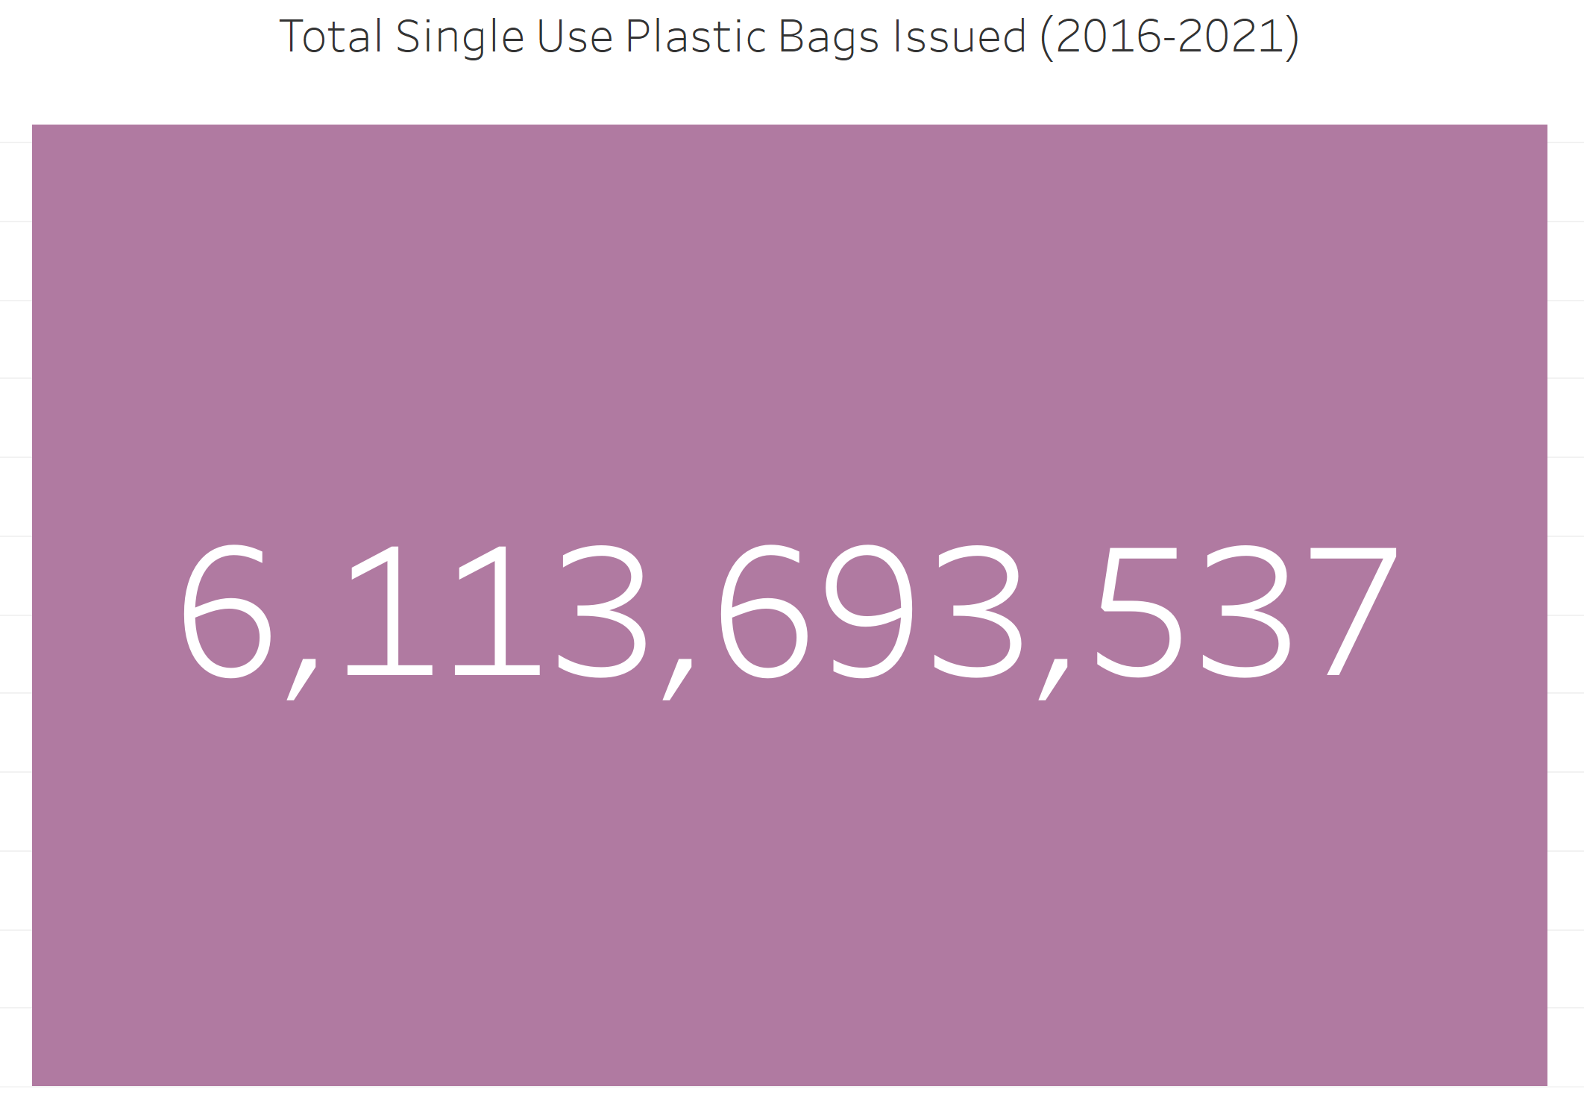
GOVERNMENT POLICY
In 2016, the UK government introduced a law where all companies (with over 250 employees) must charge 5p for Single Use Carrier Bags.
This surcharge increased to 10p on May 2021.
*For England only
Notes:
5. Back in 2016, the government initially introduced a 5p surcharge that increased to 10p for all companies with over 250 employees.
A massive total of 6.1B single use plastic bags were issued by companies between 2016-2021 in England alone.

Slide 6
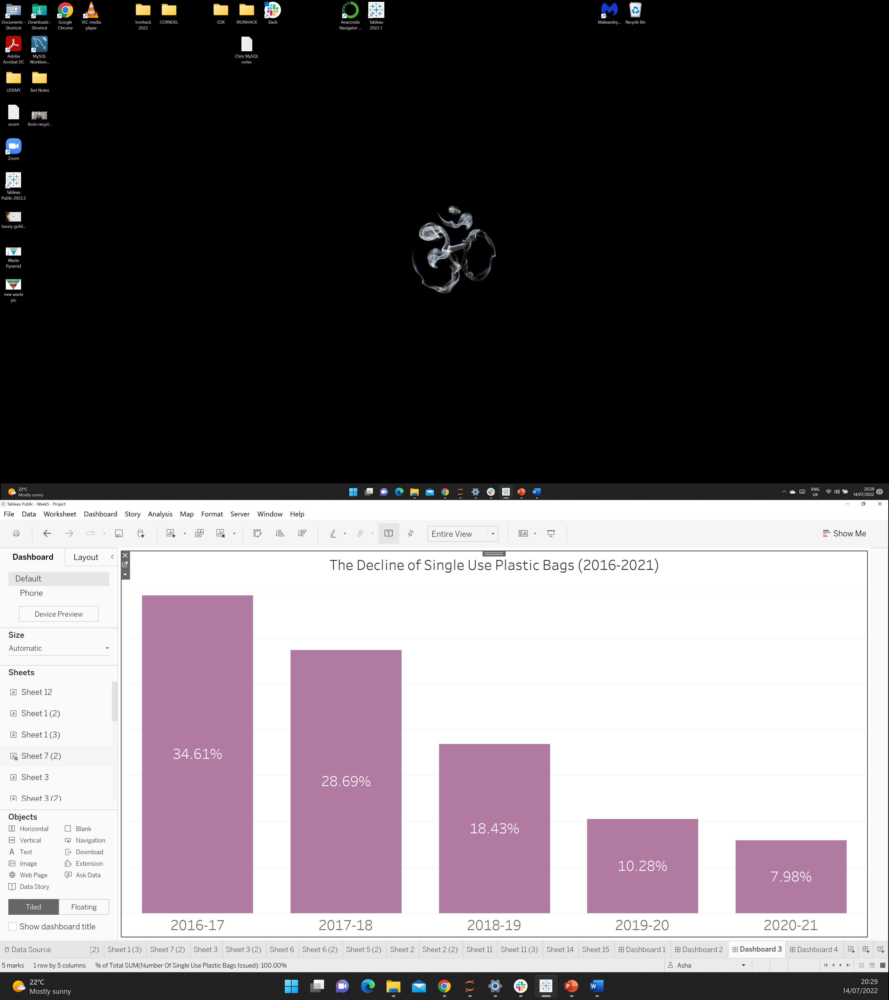
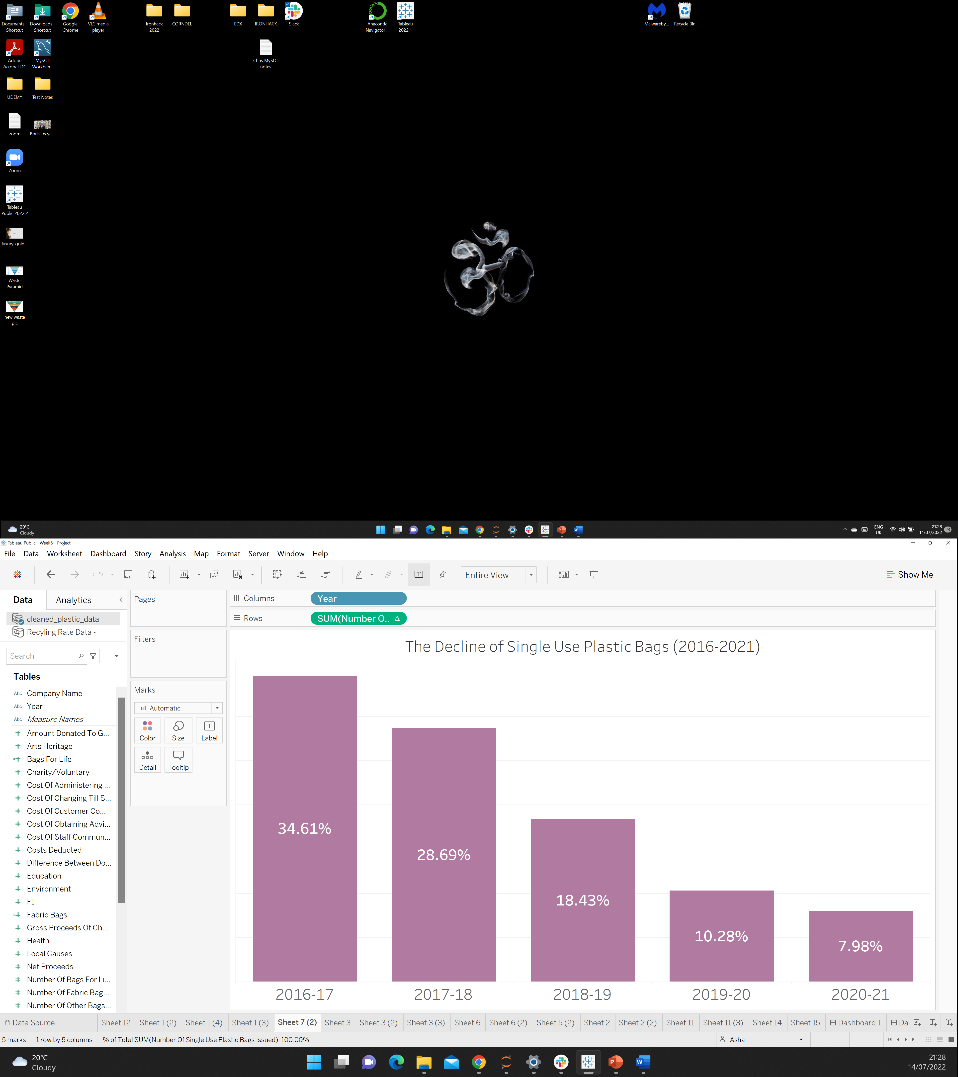
IS THE POLICY WORKING?
Biggest decrease between 2017-18 and 2018-19
People are more conscious about spending money!
Notes:
6. Since the introduction of the policy, there has been a year on year decrease in the amount of single use plastic bags issued
Which is good news, so the policy is working, because the plastic bags are no longer free and people are more conscious about spending money on them

Slide 7
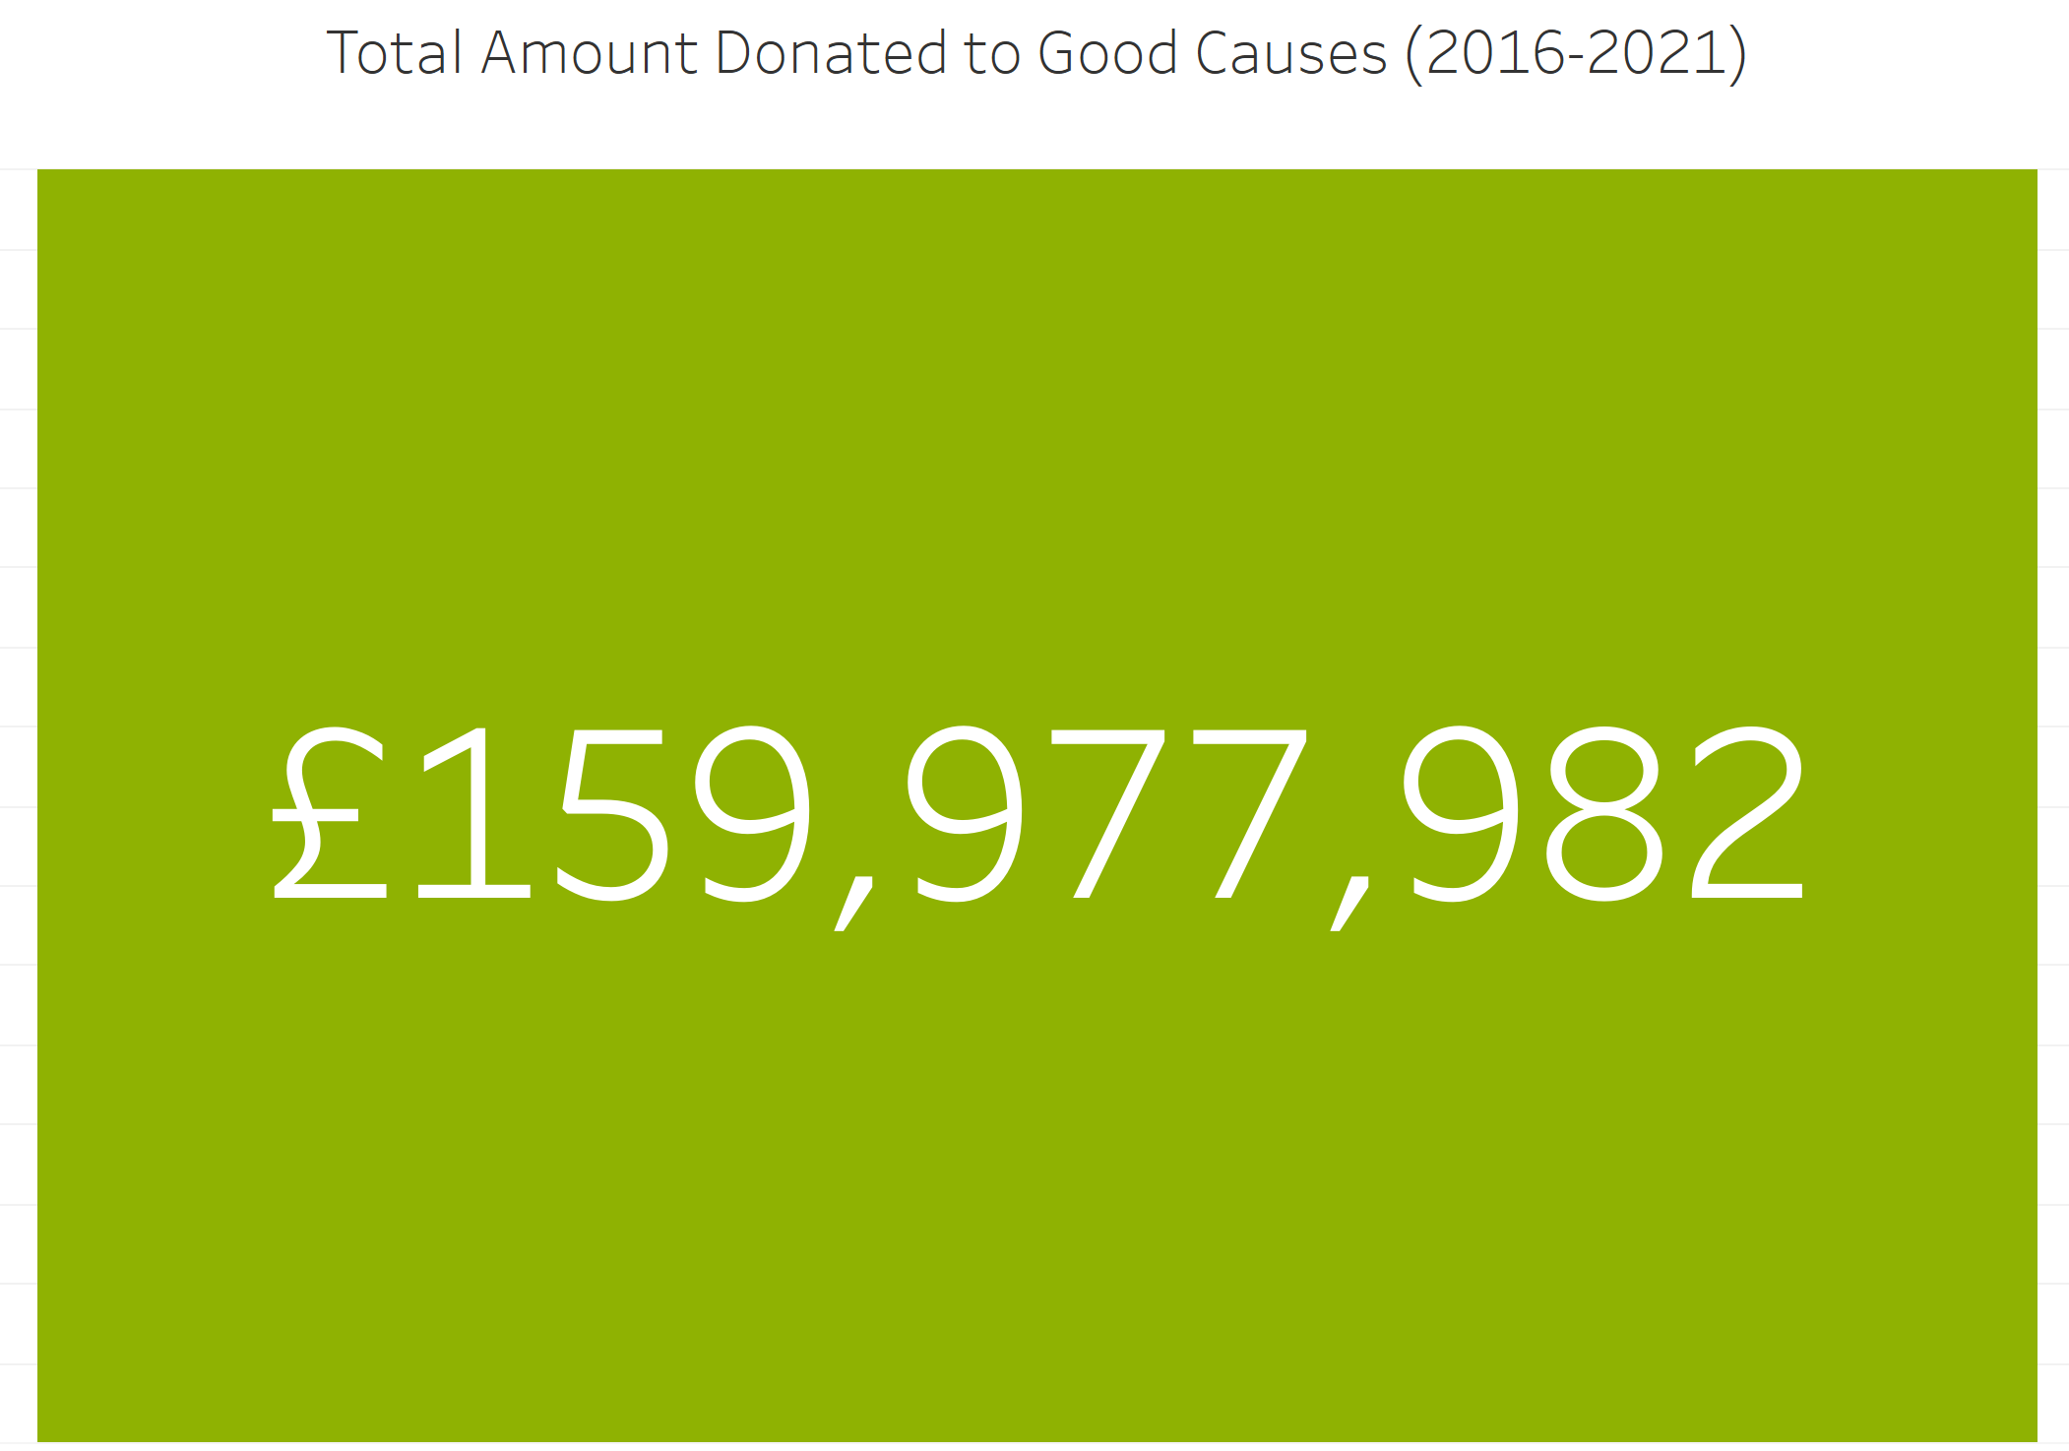
WHAT HAS HAPPENDED TO THE MONEY GENERATED VIA POLICY IMPLEMENTATION?
Plastic bags are bad for the environment, but some good is being done with the proceeds generated
*For England only
Notes:
7. So what happens to this money that the public gives to the companies?
Well its donated, almost £160 million pounds was donated between 2016-2021.

Slide 8
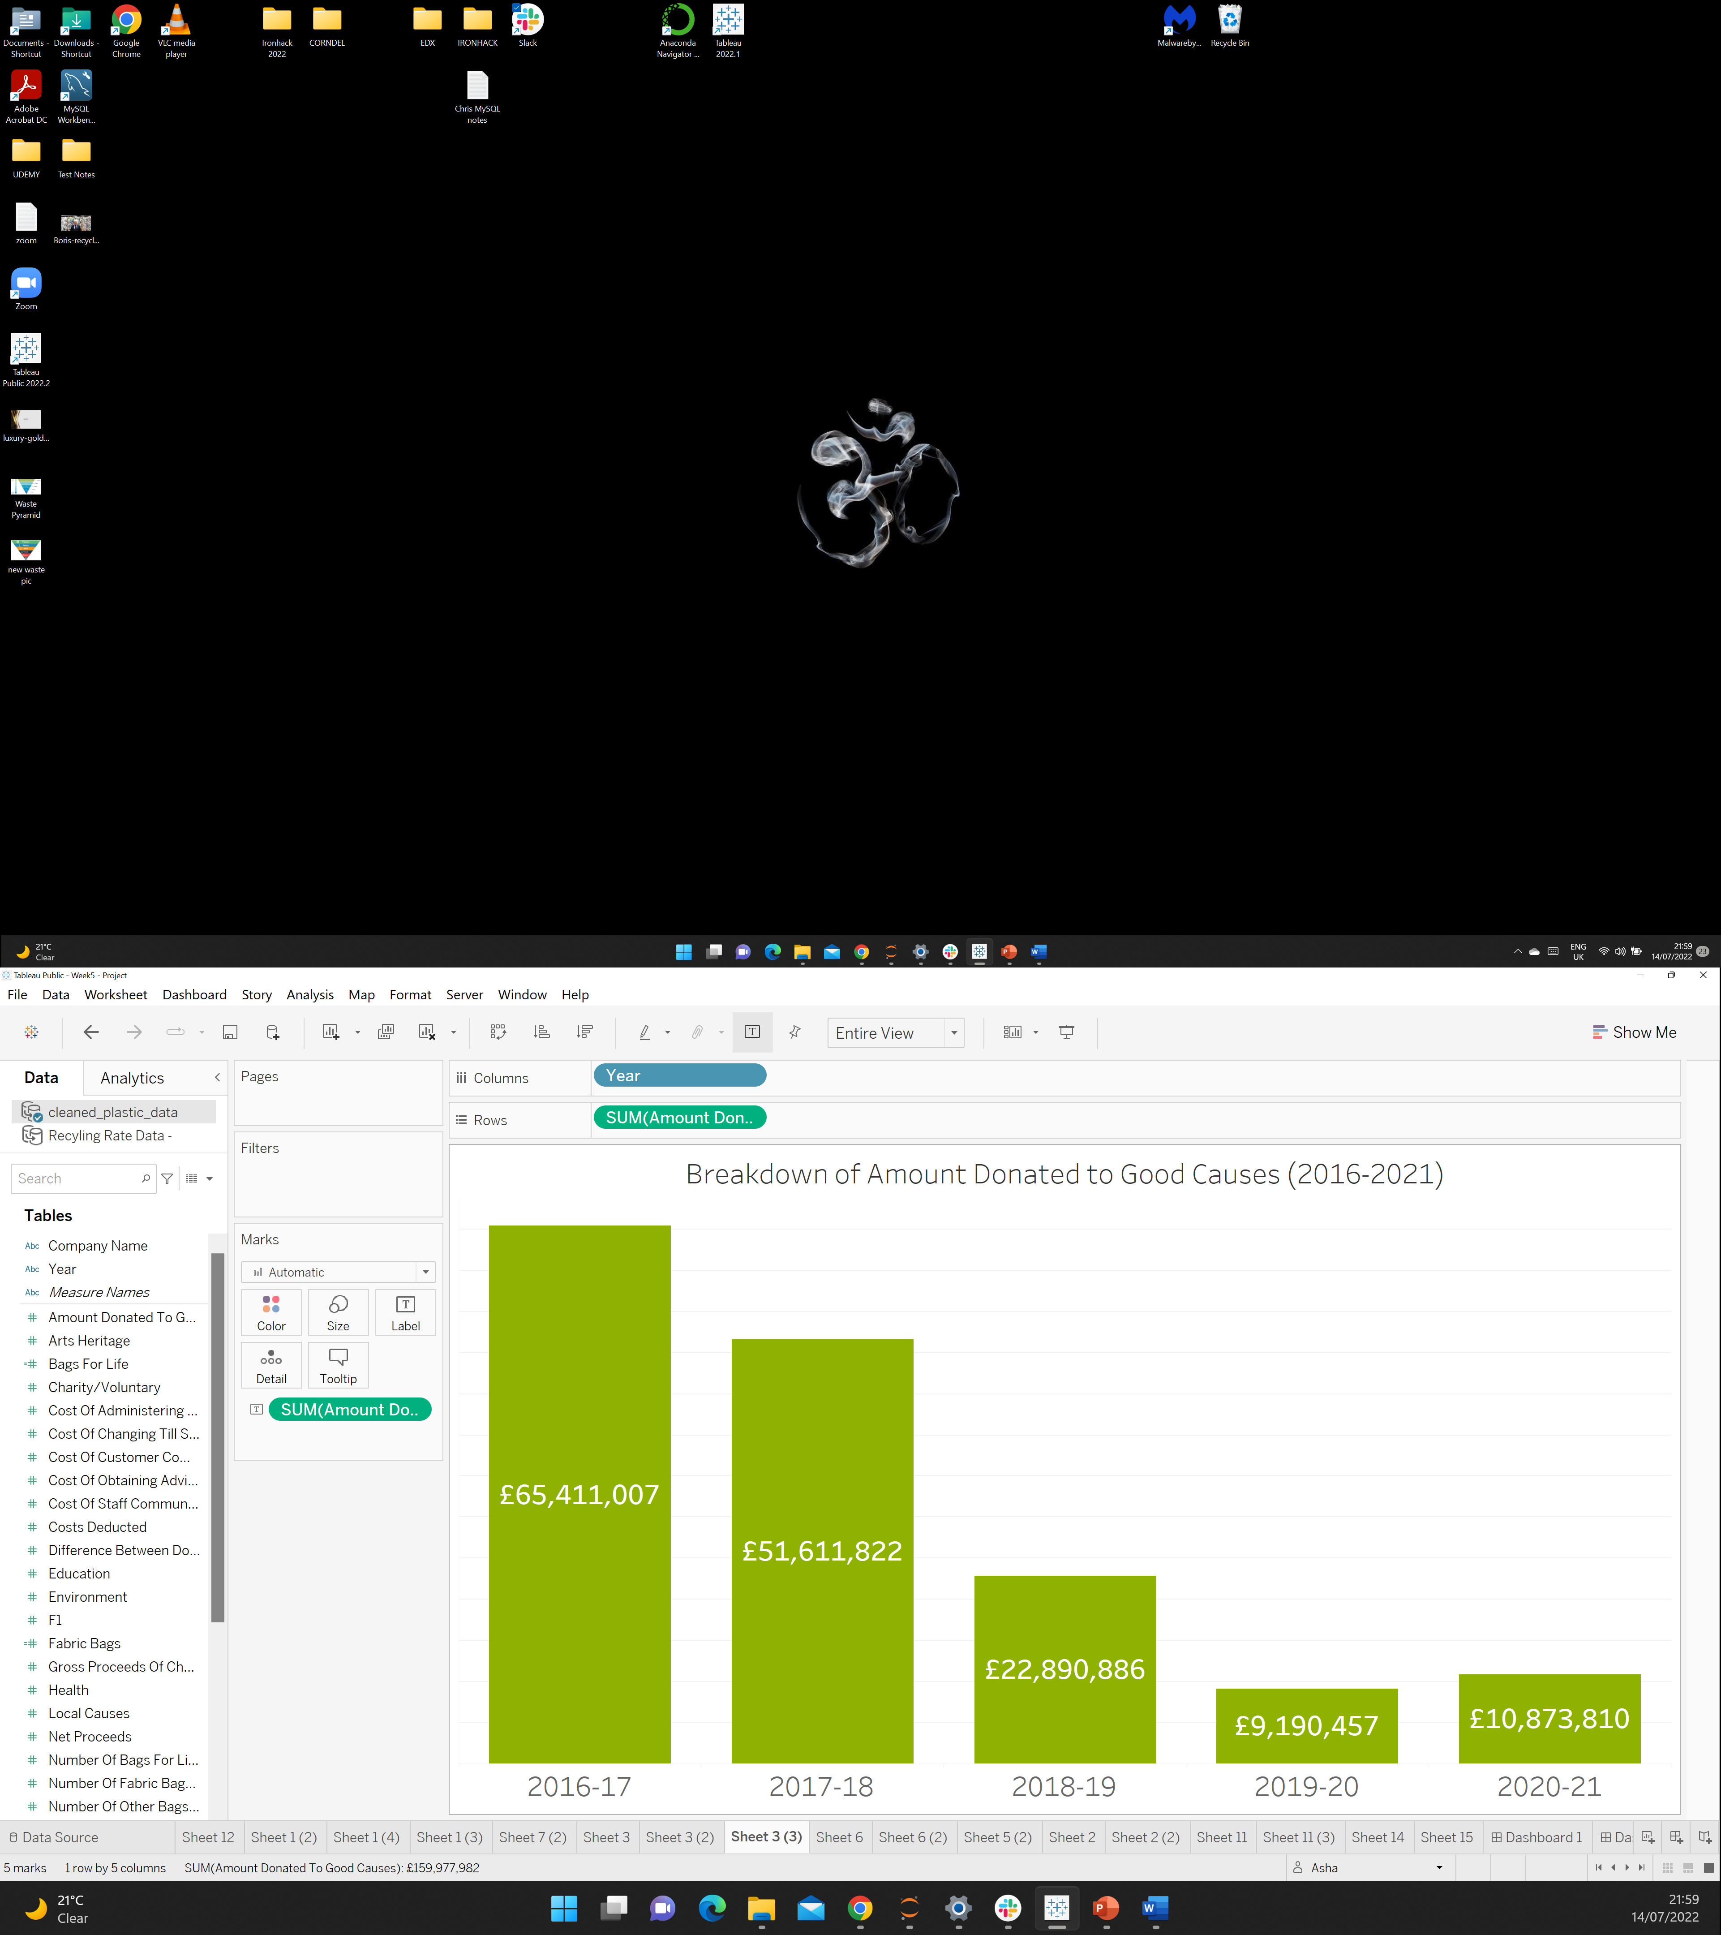

WHAT HAS HAPPENDED TO THE MONEY GENERATED VIA POLICY IMPLEMENTATION?
The amount being donated is decreasing
With the exception of 2020-21 (When Covid-19 hit)
Notes:
8. A side effect of the government policy is that the amount that is being donated is reducing because the number of single use plastic bags are also reducing. With the exception of 2020-21.
However its interesting to note: that during the Covid-19 period, many companies such supermarkets stopped actually charging customers the surcharge for online deliveries.
The government actually paused the surcharge during Covid-19.

Slide 9
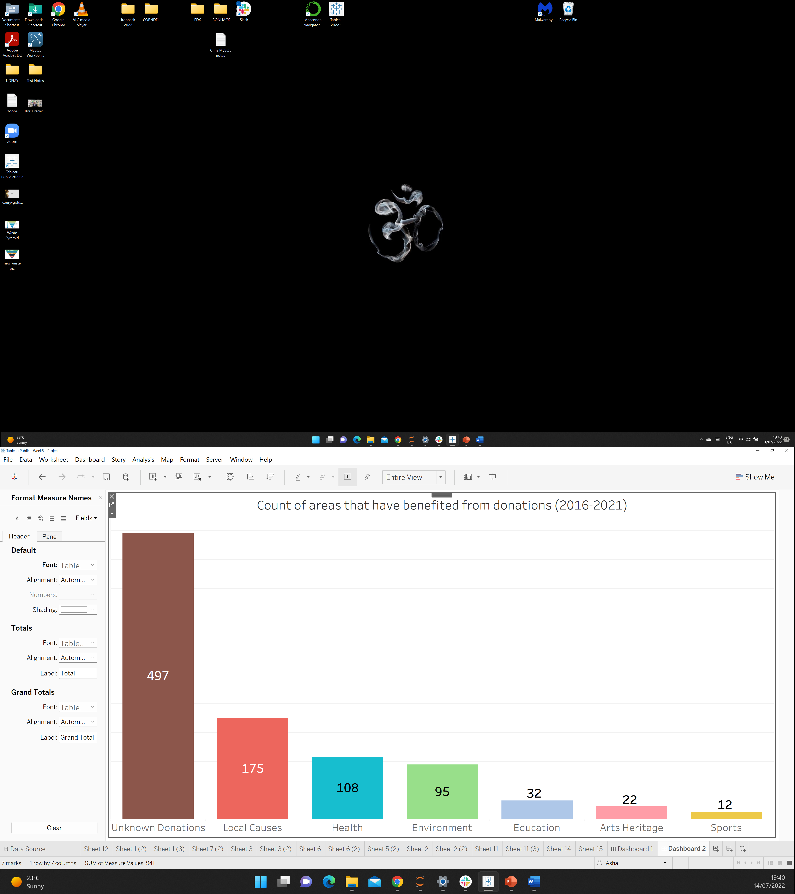

WHERE ARE THE DONATIONS GOING?
Many companies have donated but have not reported where exactly
The money generated from sales is being put to good use
Notes:
9. If we look at what sort of areas the money is going to
Most of the companies are pretty secretive about where they donate but its all going to good causes.
Its good to see some of the money is also going back into the environment.

Slide 10
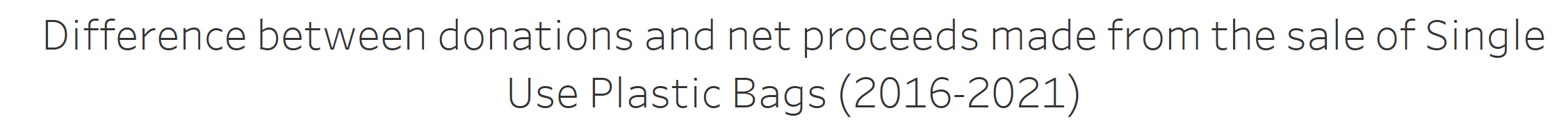
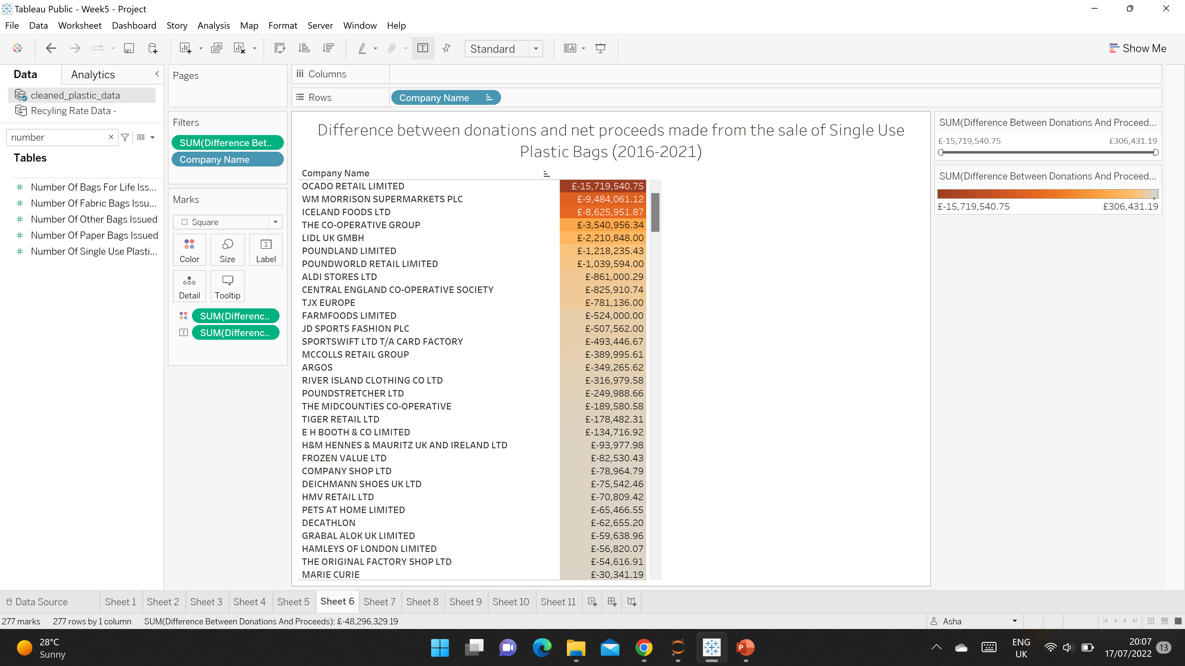
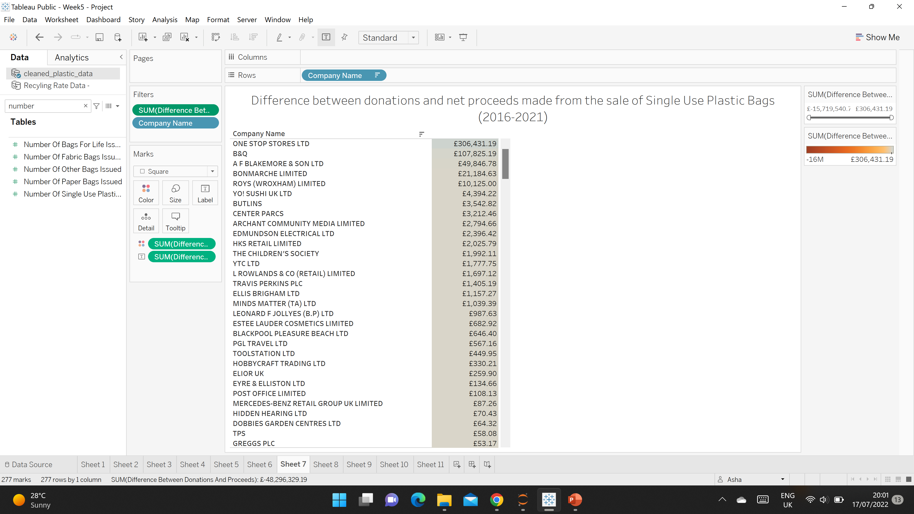
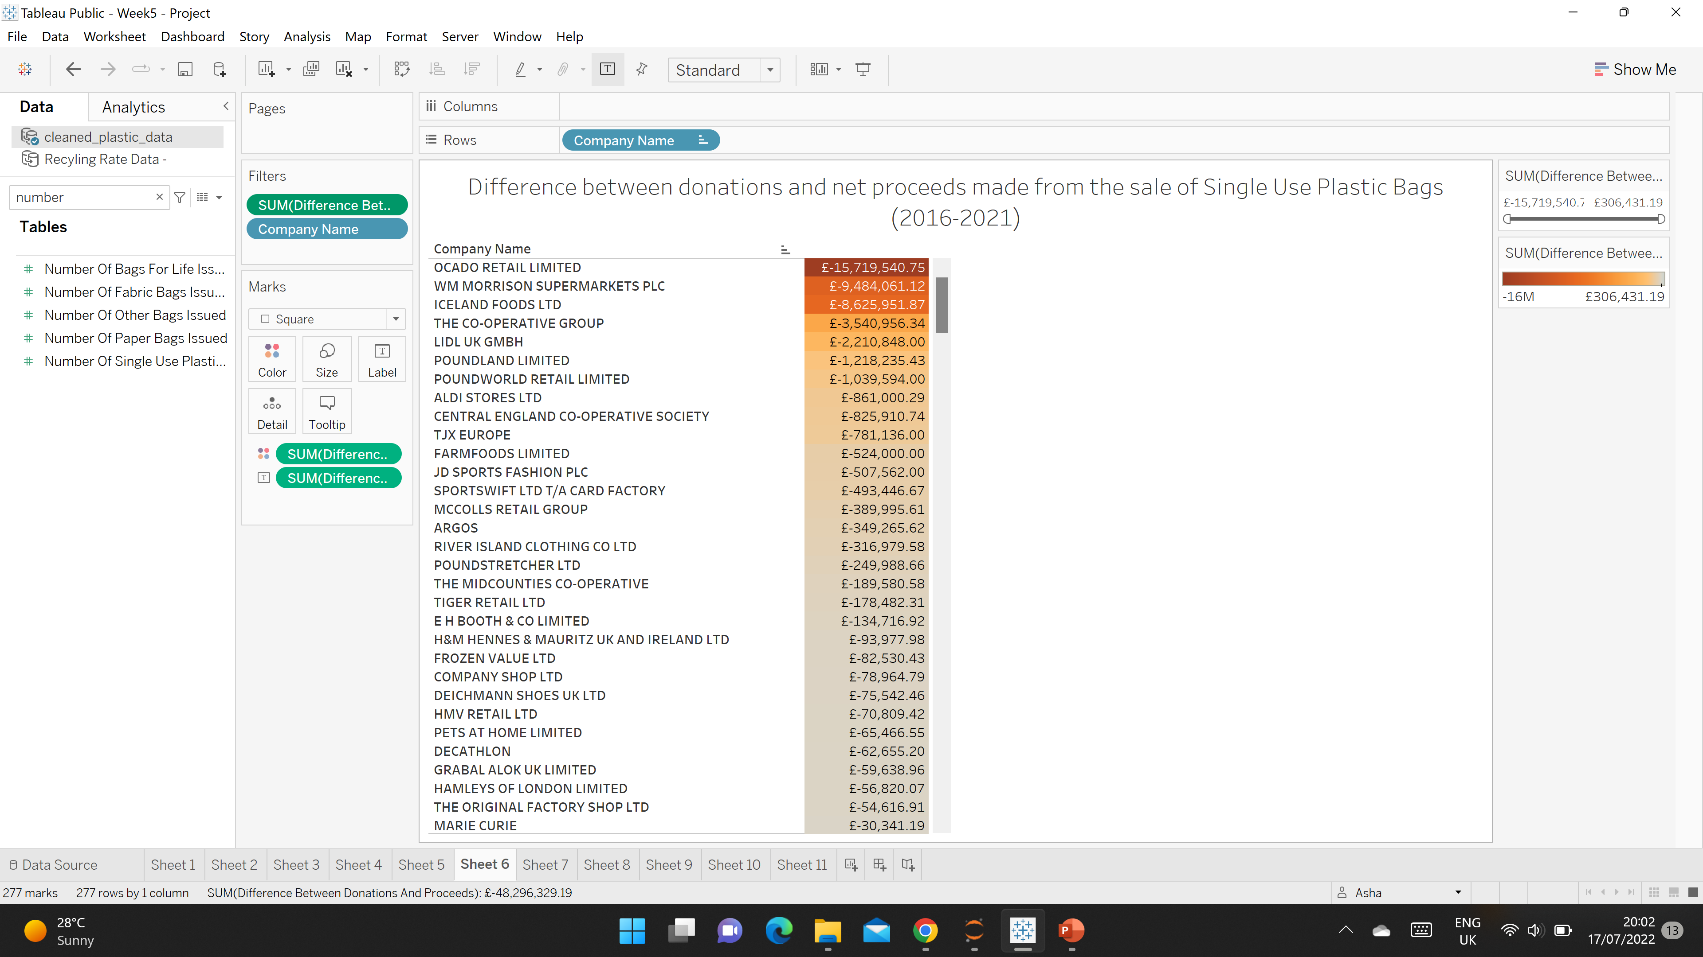
ARE SOME COMPANIES DONATING EXTRA ON TOP?
Notes:
10. I wanted to know if some companies are donating extra. So if we look at the total amount donated and we deduct that from the net proceeds generated after all costs associated with single use plastic bags have been deducted. We can see that there are actually some companies who add on money, which is good
However, there are also companies that deducted alot of money... And its mainly supermarkets.

Slide 11
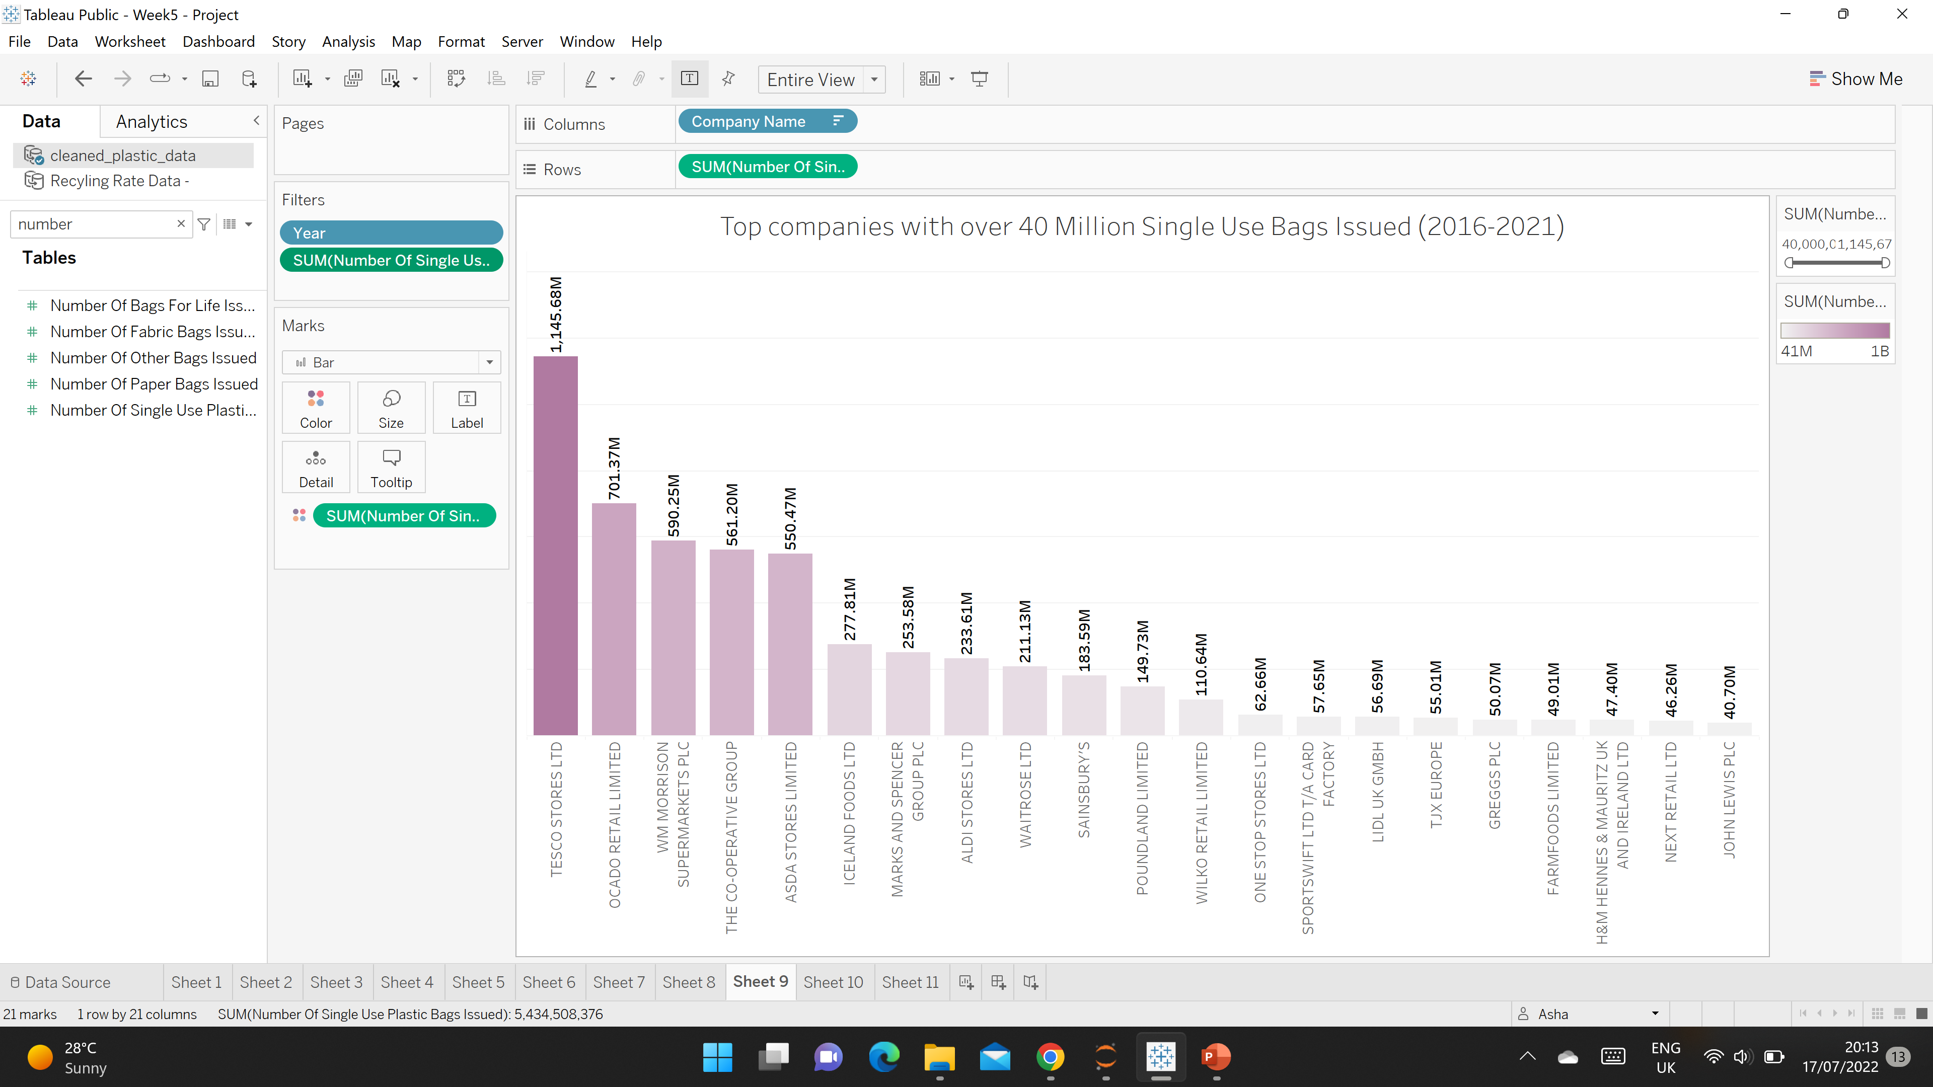

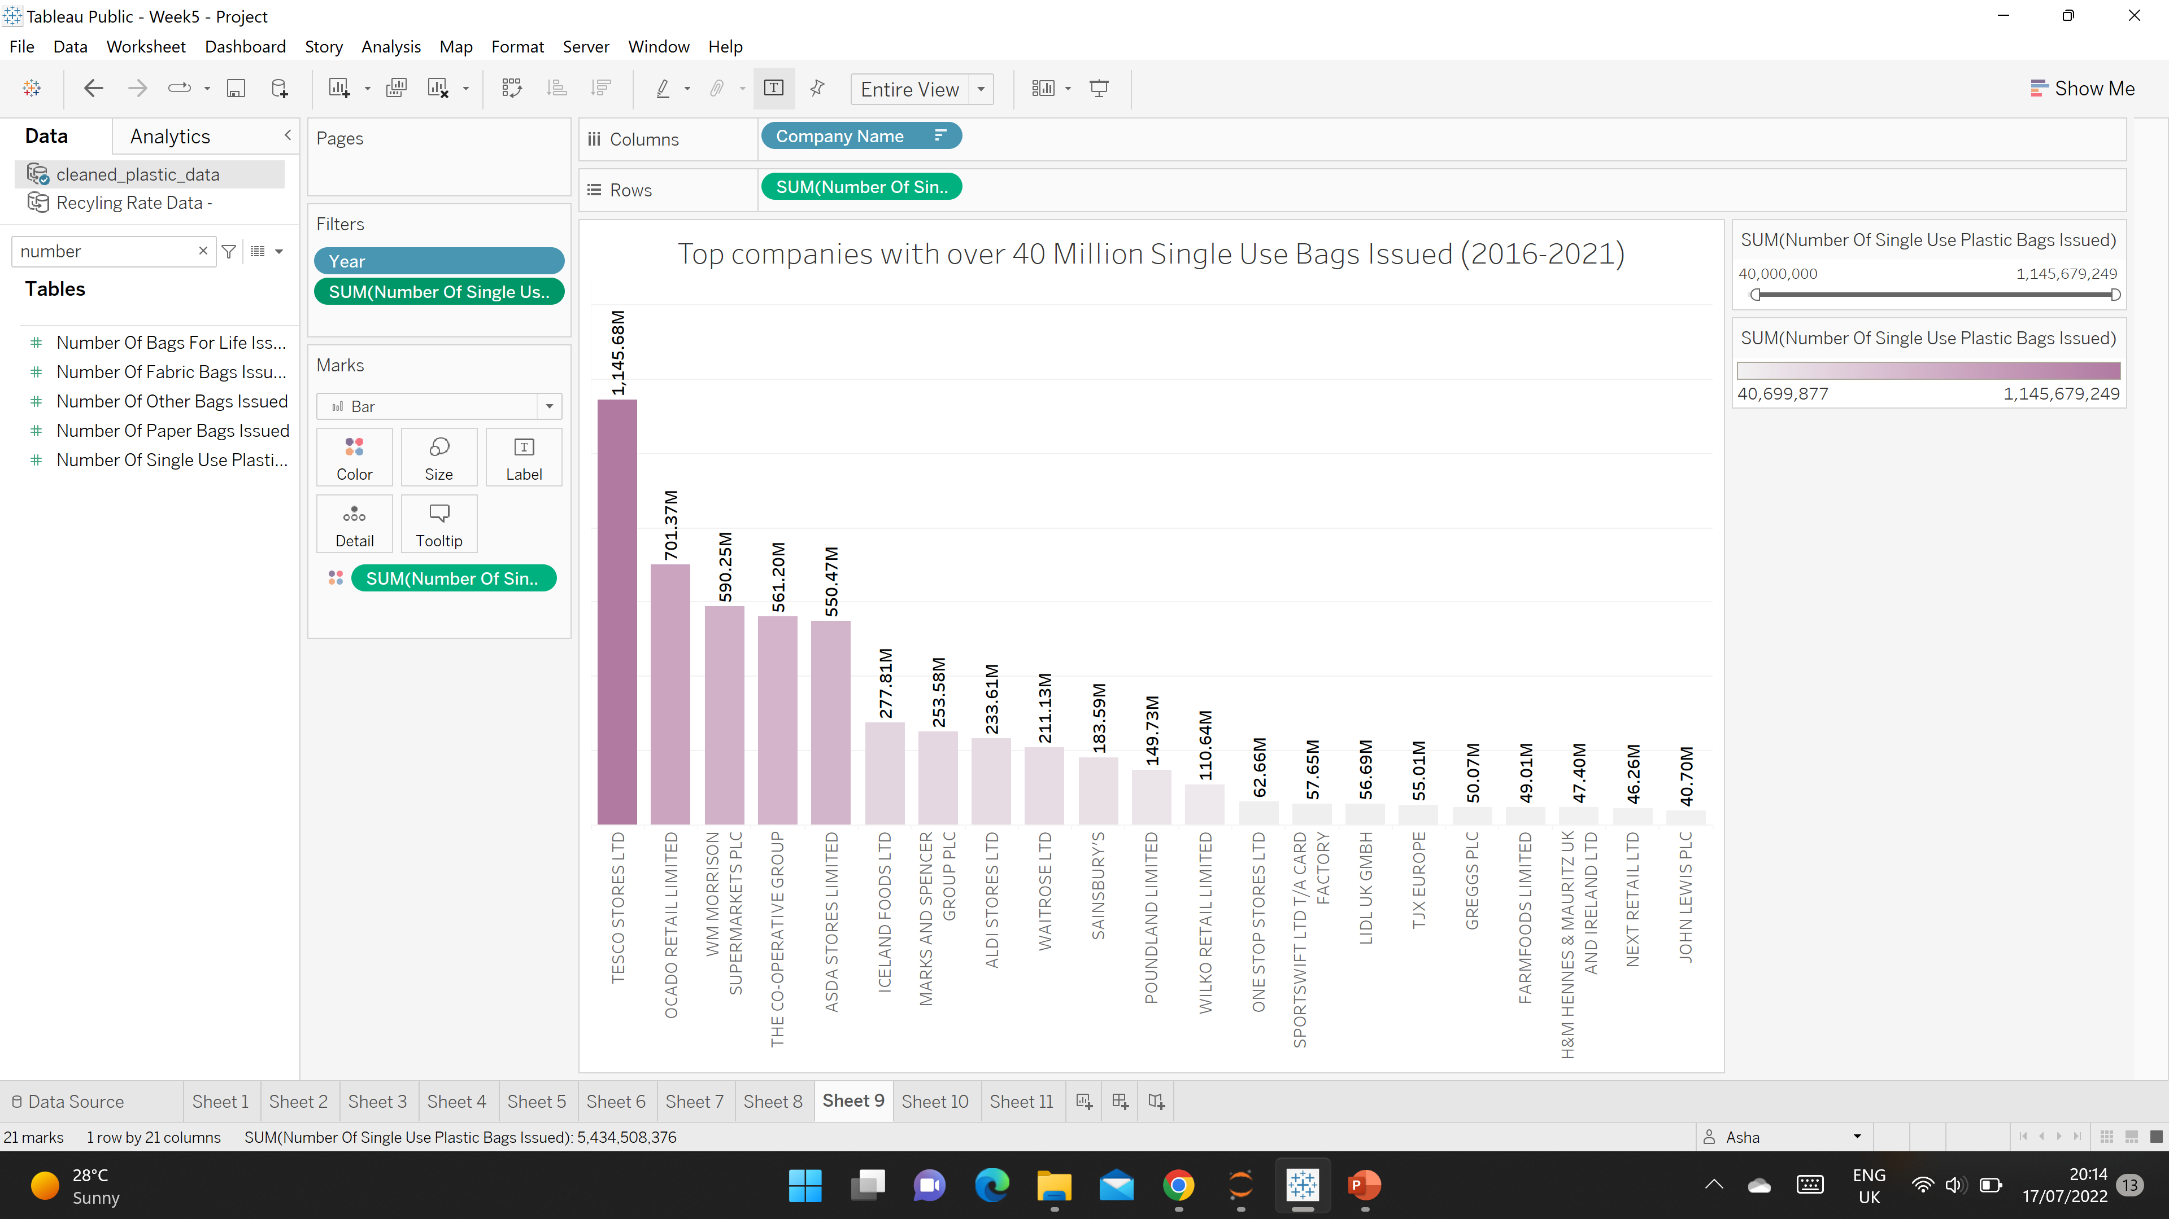
WHICH TYPES OF COMPANIES ISSUE THE MOST SINGLE USE PLASTIC BAGS?
Tesco – 1.13 Billion sold
Most companies are supermarkets
Notes:
11. So if we look at the types of companies that are issuing the most single use plastic bags they are infact supermarkets
So this is where the government needs to focus, if they want to reduce plastic more. Tesco is one of the largest supermarkets and its issued over a Billion single use plastic bags.

Slide 12
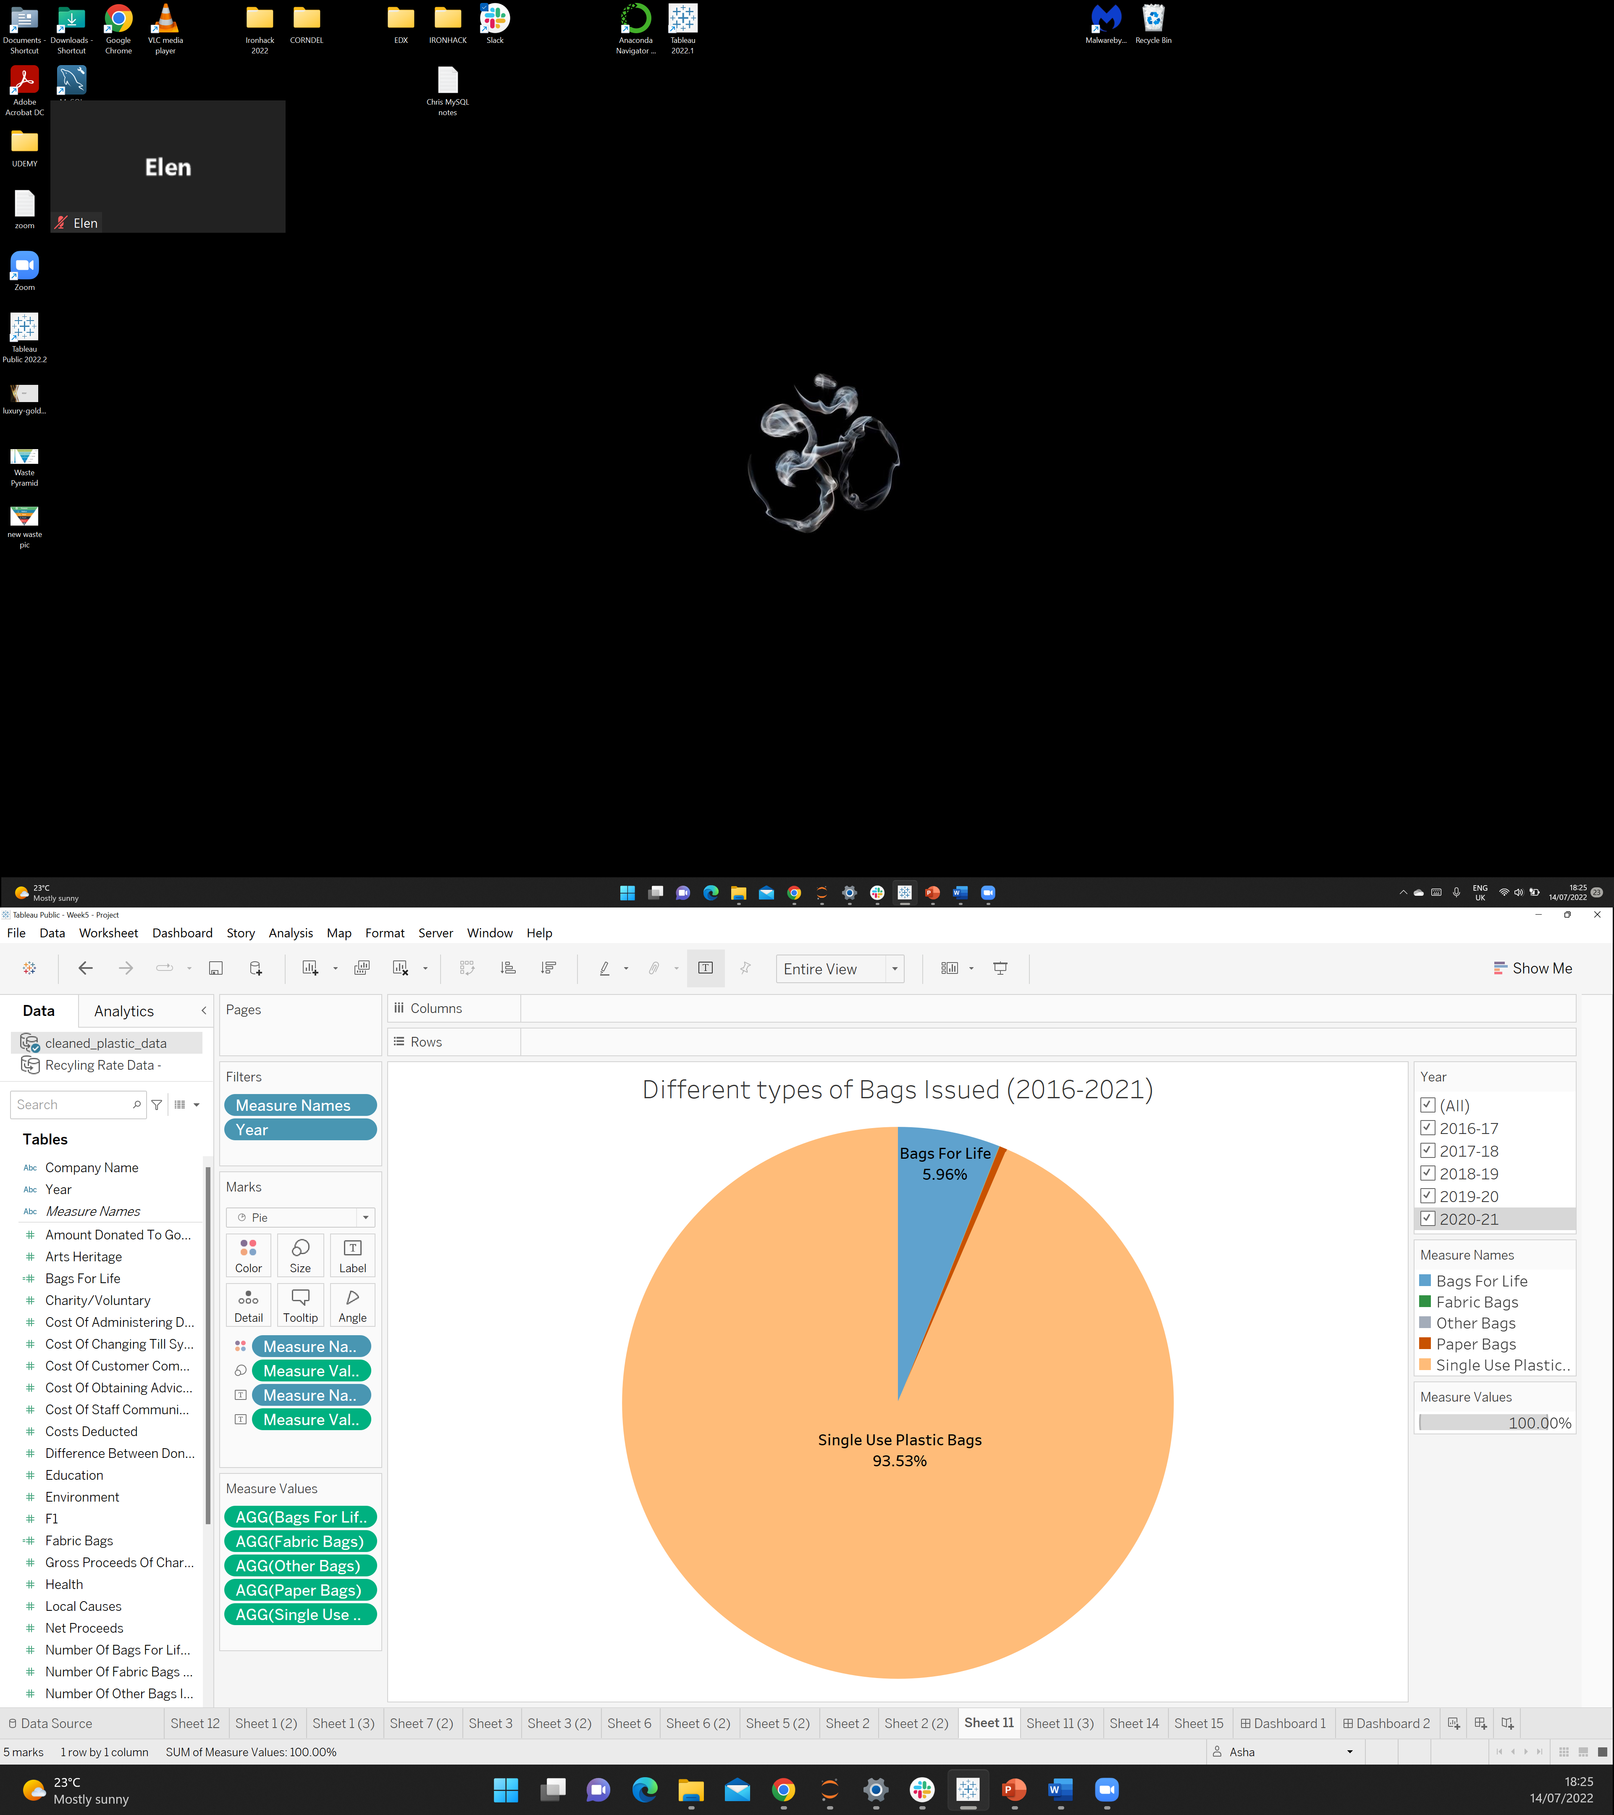
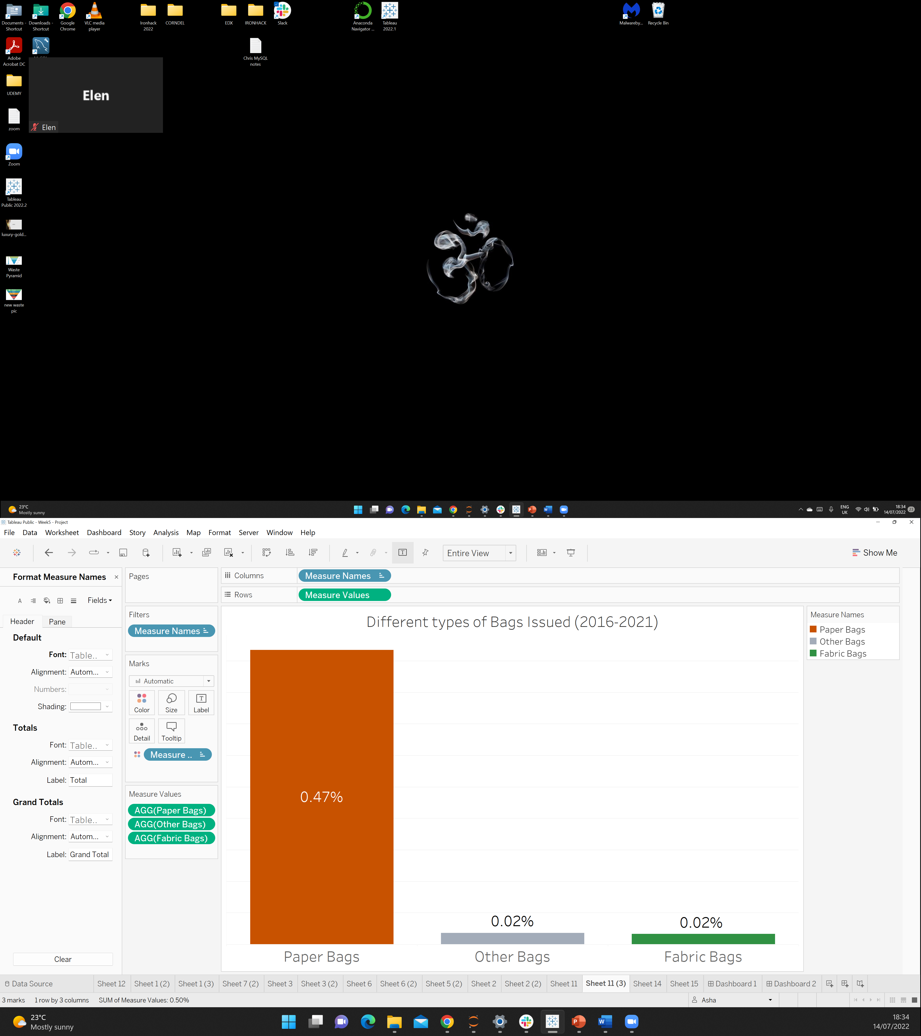
BUT WHAT ABOUT OTHER TYPES OF BAGS?
Notes:
12. What about other types of bags?
Well plastic is the popular choice, bags for life are just plastic bags that are more durable and expensive.
However, if we zoom in and look at the other types of bags such as paper and fabric. The % is very low. Not enough companies are stocking up on these types bags.

Slide 13
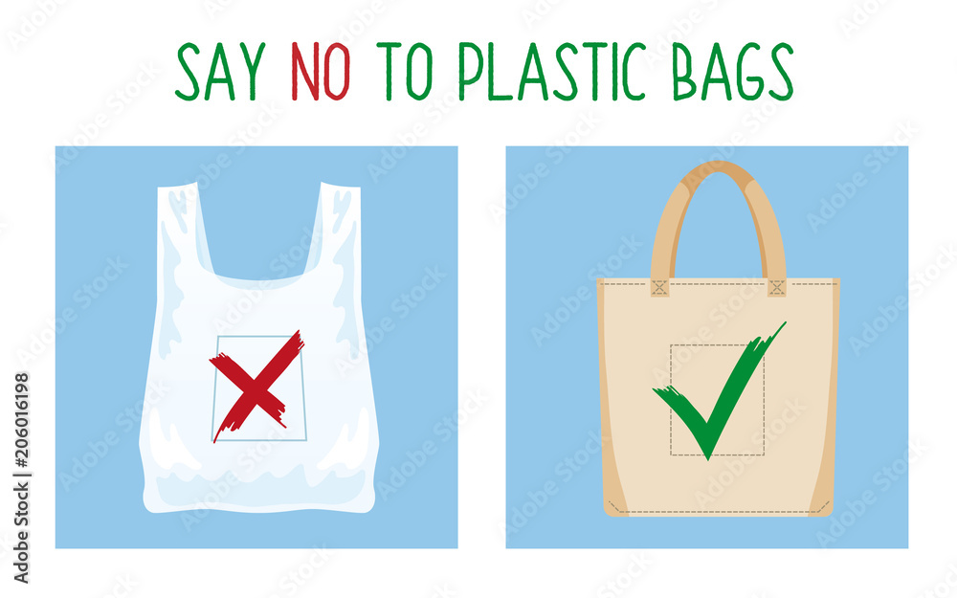
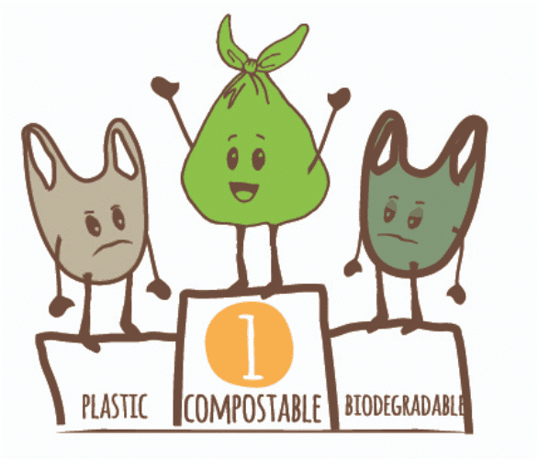
WHAT MORE CAN WE DO? - SUGGESTIONS FOR IMPROVEMENT
Supermarkets can stop selling plastic bags
Supermarkets can offer paper bags
“Green environmentally friendly carrier bags” options:
Compostable bags that made from natural starch
Biodegradable bags - sustainable material derived from ethanol (from sugar-cane)
Source: https://www.mindbodygreen.com/articles/biodegradable-trash-bags/
Notes:
13. What can we improve? Well I guess the government could issue further laws which make companies charge twice the amount.
But this would be hugely unpopular with the public.
So companies such as supermarkets could infact stop issuing single use plastic bags like some other countries have done.
Companies can also look at alternative materials such as Paper, Compostable and Biodegradable bags. But these are just a few suggestions

Slide 14
THE END
THANK YOU FOR LISTENING!
Dataset Sources:
https://www.data.gov.uk/dataset/682843a8-168c-4056-b6fe-741161a39f60/single-use-plastic-carrier-bags-charge-data-for-england
https://www.gov.uk/government/statistics/uk-waste-data/uk-statistics-on-waste

